Slide 1

Personal Loan Campaign
Tanisha Kapoor
NiveditaChaudhari
CoderGirl Data Science
11 August 2021

Slide 2
Brief Overview
Dataset Used : “Personal Loan Modeling” which is available on Kaggle.
There are 14 features (independent variables) and 1 target (dependent) variable for 5000 customers.
Target variable (Personal_Loan) indicates whether customer accepted personal loan offered in the last campaign or not.
Problem Type : Binary classification problem as the target variable has two classes (1/0)
Problem Statement
To build a machine learning model which can predict:
Whether a liability customer will buy a personal loan or not.
Which variables are most significant.
Which segment of customers should be targeted more.

Slide 3
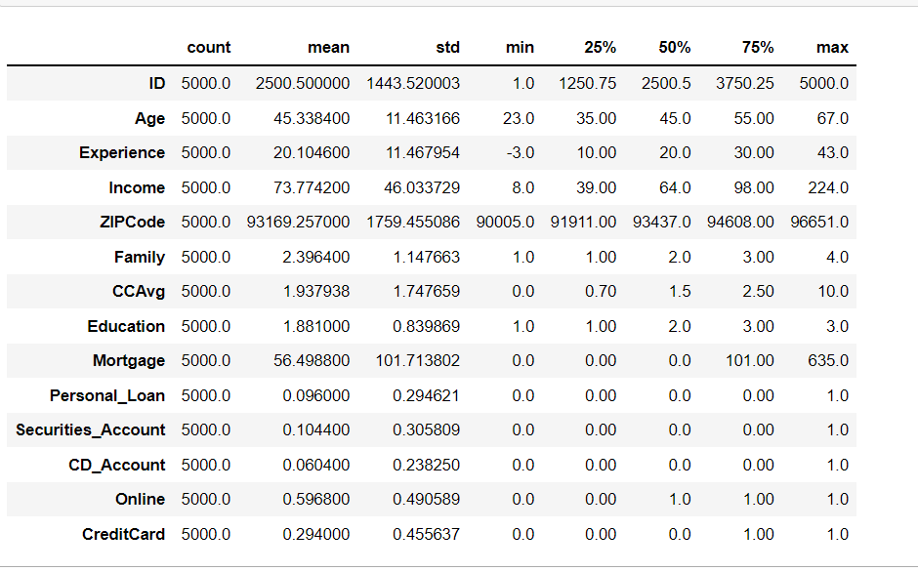
Data Description
Average age of customer in given data set is 45.34
Average experience of customers in years is 20.10 years. But experience Variable has -ve values which is not correct, this need to be fixed
Average income of customer in dollars is 73.77K
Average family size is 2.4
Average amount spent by customer on credit cart in dollars is 1.93K
On an average most of the customer are Under graduate or graduate
Average house loan customer availed in dollars is 56.5K
For variables: Income, CCAvg, Experience, Mortgage, Security_Account, CD_Accounts, CreditCard has big difference between mean Vs Max values, which suggest that there are some extreme values or possible outliers

Slide 4
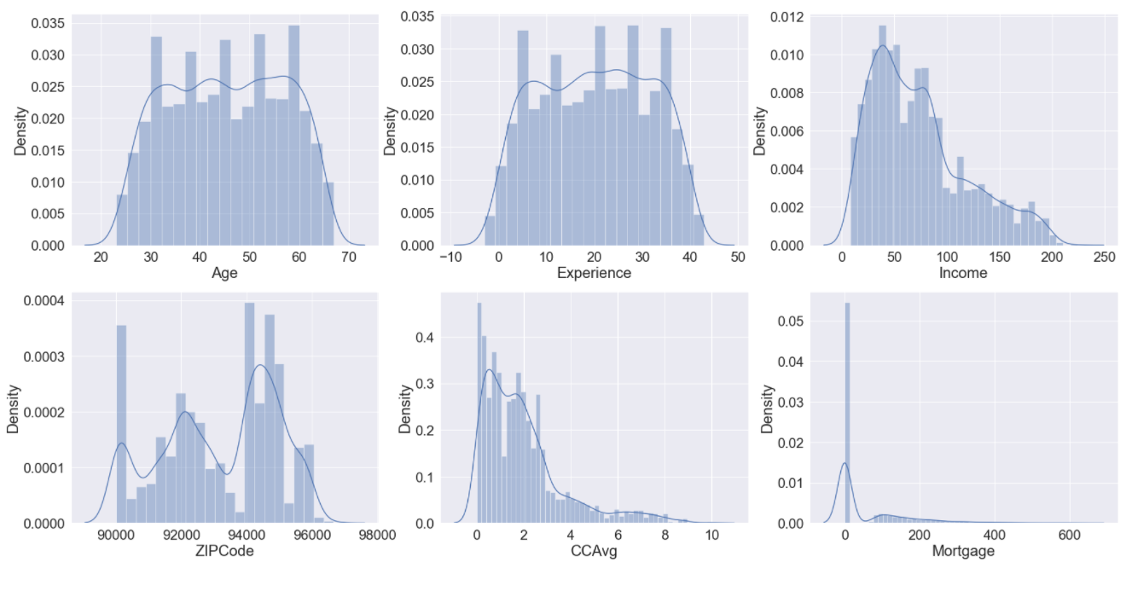
EDA : Univariate Analysis of Continous Variables
Age variable is normally distributed with majority of customers falling between 30 years and 60 years of age.
Average experience customers has in years is around 20years.Experience variable has some negative value, which should be fixed. It is normally distributed.
Income is right skewed.Therefore, income mean(73.77) is higher than median(64)
CCAvg is right skewed having mean higher than it’s median.
Mortgage contains most of the values as zero. It also contains many outliers.

Slide 5
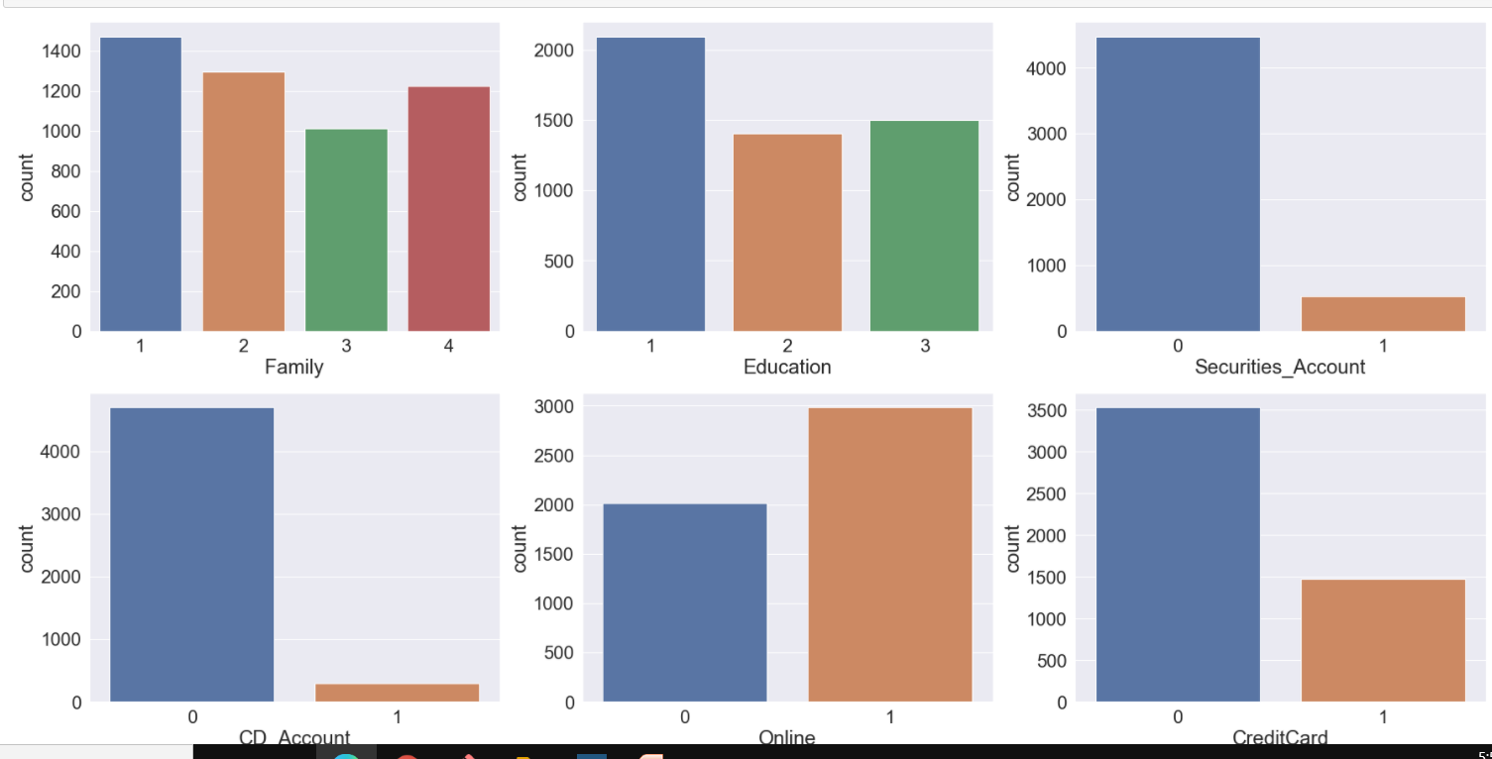
EDA: Univariate Analysis of Categorical Variables
Observations :
Family size for most of the customers is 1
Education level for most of the customers is Undergraduate
Most of the customer don't have CD_Account, Credit Card and Securities_Account
Customers are interested in using Online banking

Slide 6
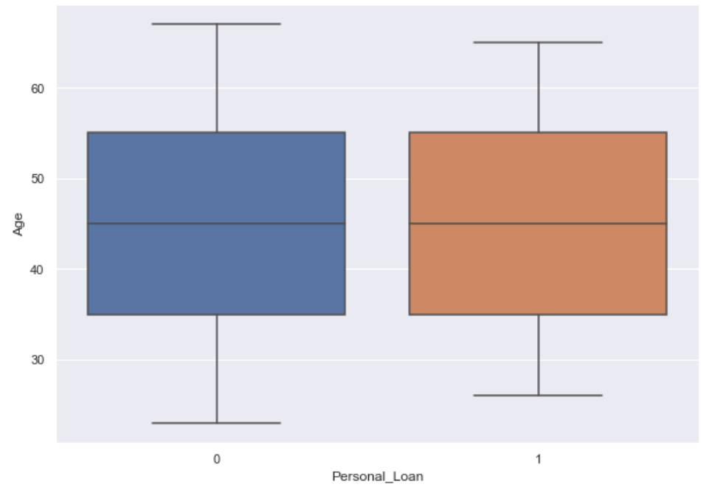
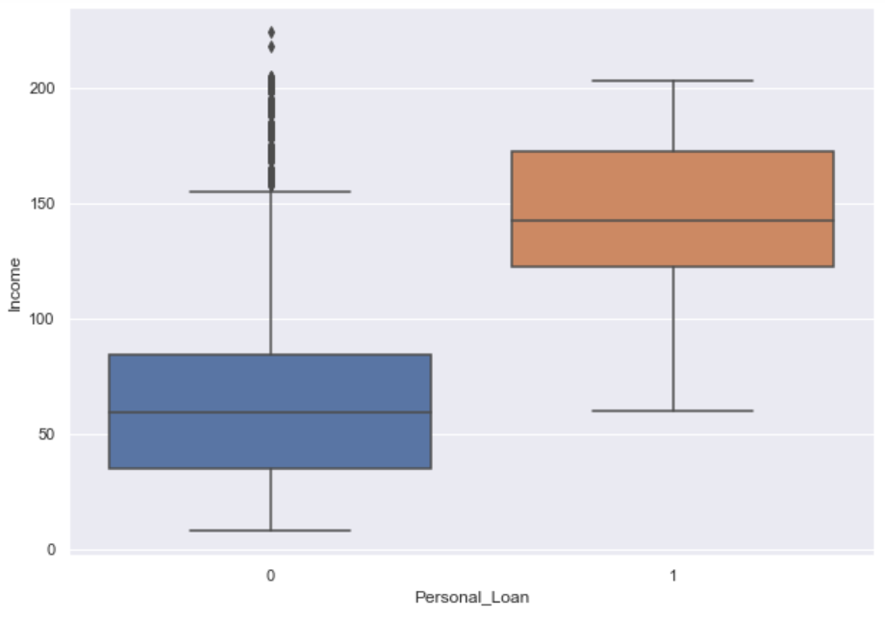
Bi-Variate Analysis
Personal Loan Vs Age and Income
Observation :
Personal Loan doesn't show variations with Age.
Observation :
Income variable seems to have good effect on Personal_Loan.
As income level of customers is increasing ,they are more interested in taking loan.
.

Slide 7
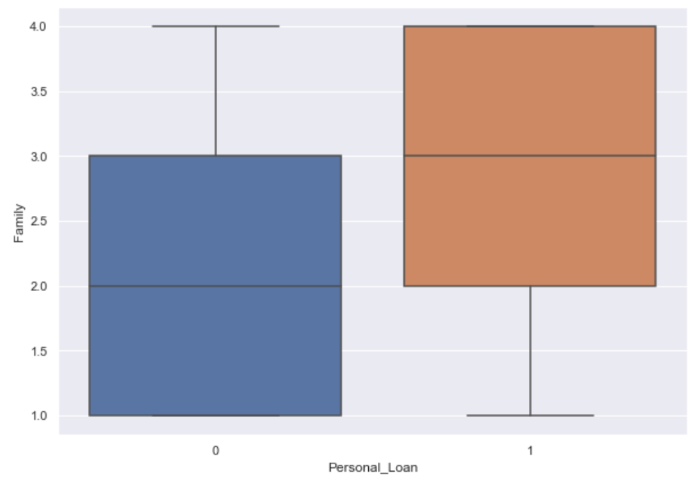
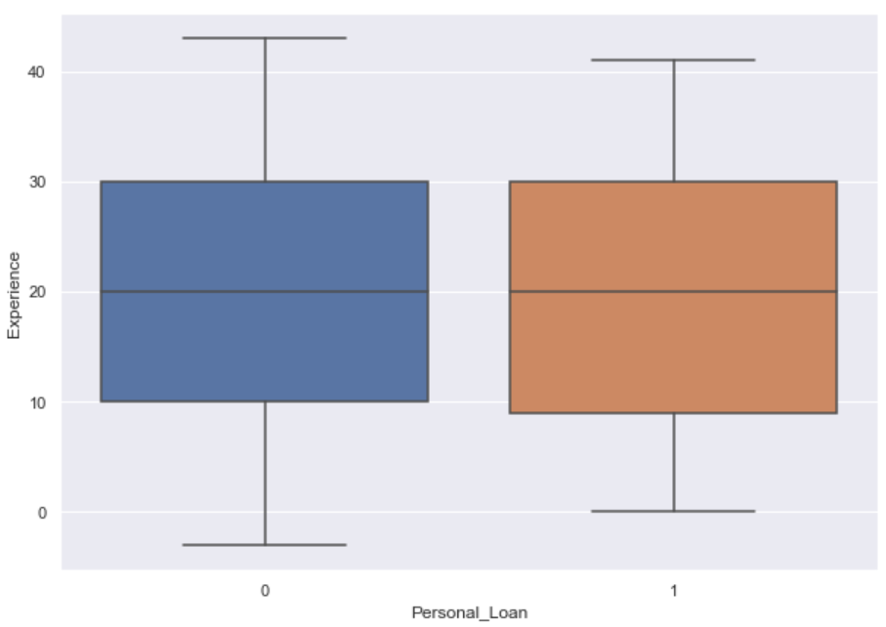
Bi-Variate Analysis
Personal Loan Vs Family & Experience
Observation:
Customers have better chance of accepting personal loan when the family size is more than or equal to three.
Observation :
Personal Loan doesn't show much variations with Experience.

Slide 8
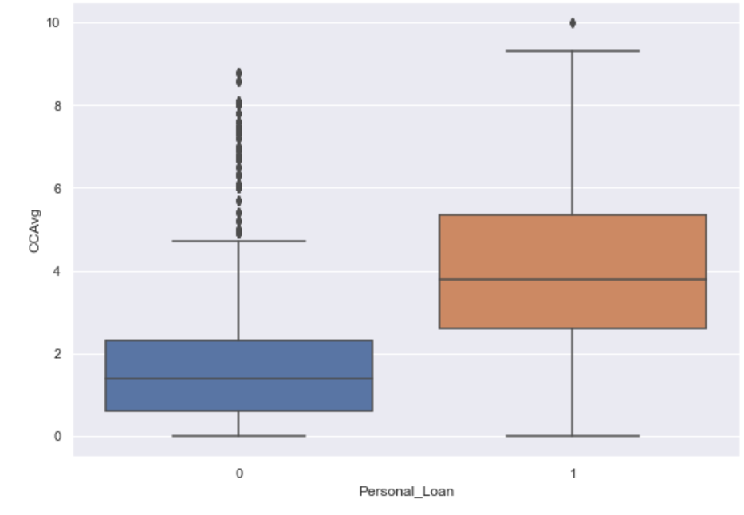
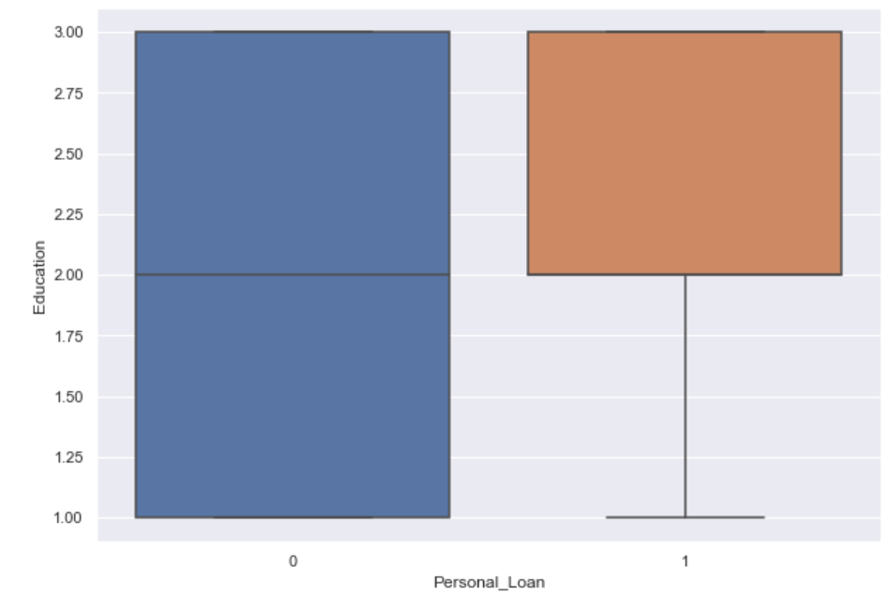
Bi-Variate Analysis
Personal Loan Vs CC Avg & Education
Observation :
CCAvg show good relationship with Personal Loan.
Customer who has more spending on Credit cards has more chances to have personal loan
Observation :
Customer with higher education levels, especially customer who are Graduate or Advanced professionals have more chances.

Slide 9
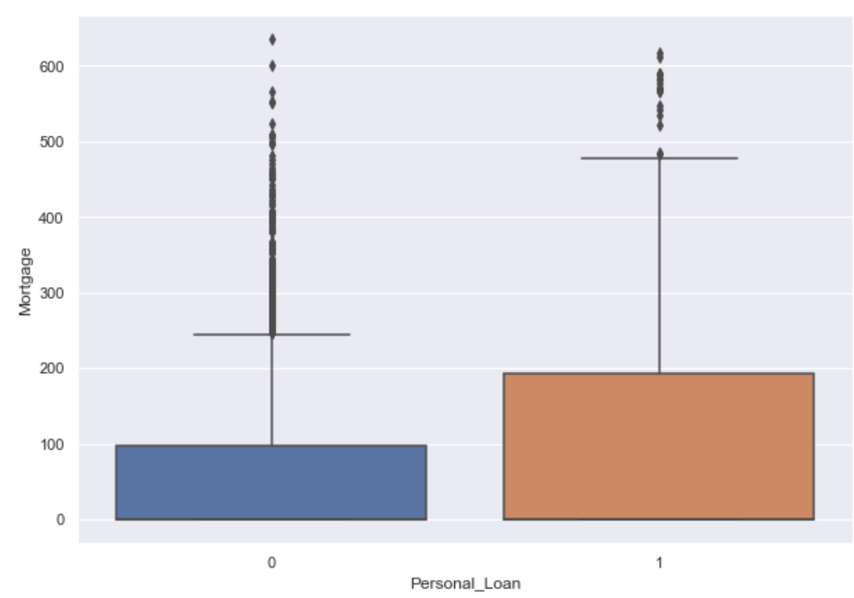
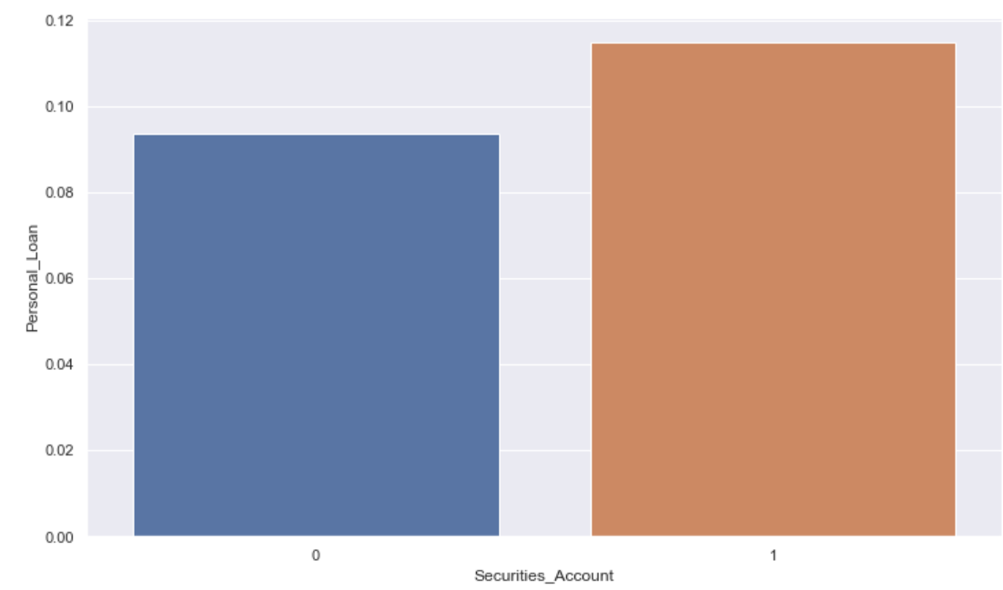
Bi-Variate Analysis
Personal Loan Vs Mortgage & Security Accounts
Observation :
Customer with more mortgage value have higher chance of accepting personal loan.
Observation :
Customer with Securities account has high chance of having personal loan in comparison to customer with no securities account.

Slide 10
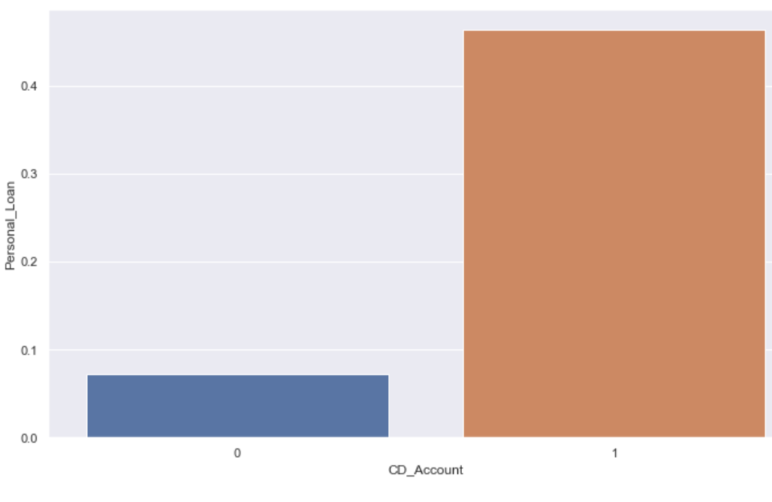
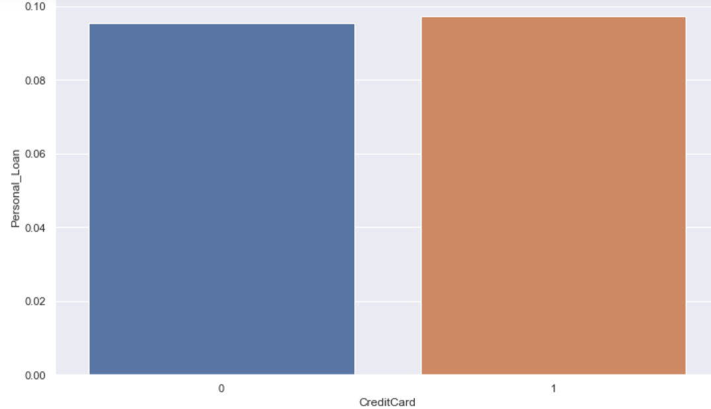
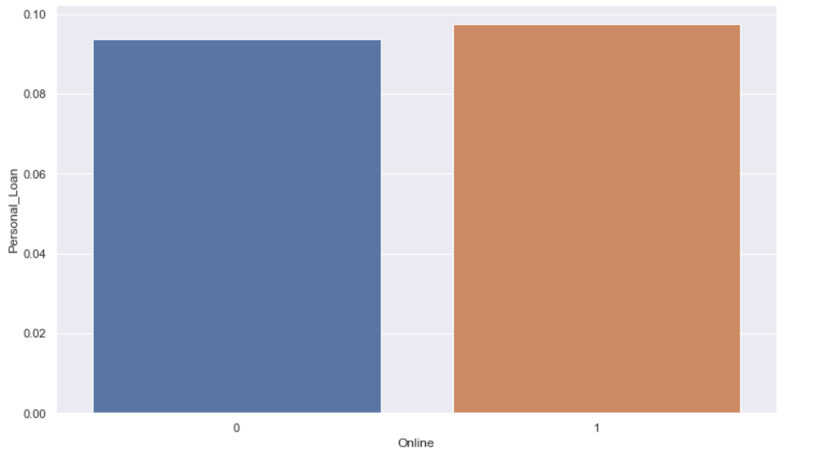
Bi-Variate Analysis
Personal Loan Vs CD Account ,Credit Card and Online
CD_Account | Credit Card | Online
Observation: Customer with CD account has high chance of having personal loan in comparison to customer with no CD account | Observation: Customers having Credit card or not doesn't have much impact on chances of customer having personal loan | Observation: Customers using online banking or not doesn't have much impact on chances of customer having personal loan

Slide 11
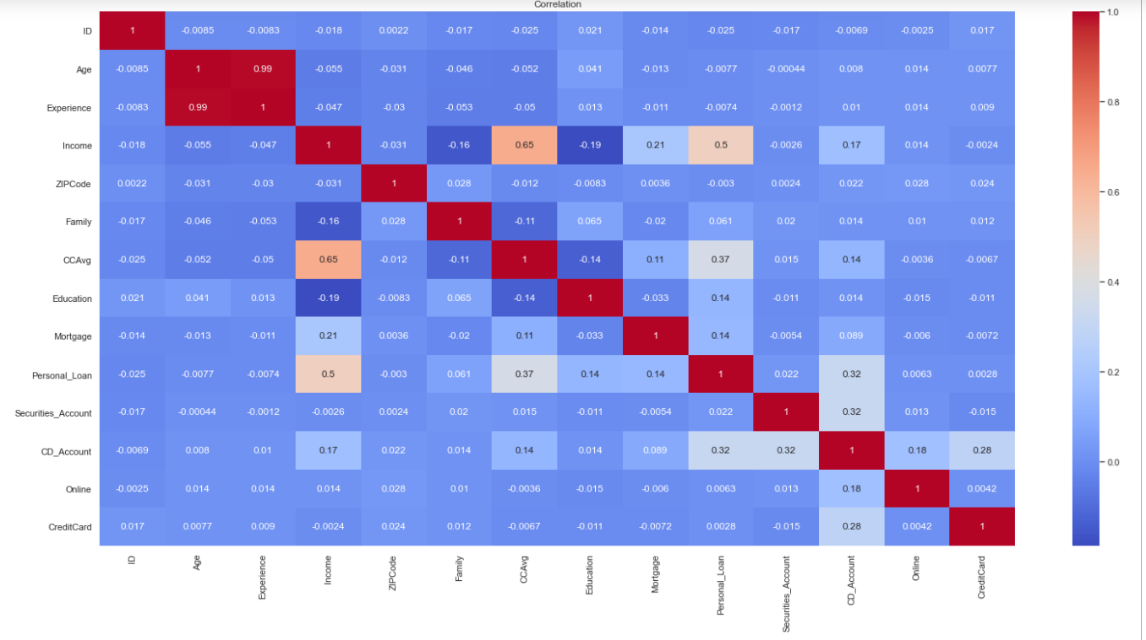
Exploratory Data Analysis- Correlation Matrix
Observation :
Personal_Loan has high correlation with Income, Credit card average spending(CCAvg) and CD_account.
In other variables we see high correlation between Age and experience of 0.99.These 2 variables can have multicollinearity.
Income and CCAvg are highly correlated with each other at 0.65.
Personal loan doesn't seems to have any major correlation with experience.
Income and CCAvg have a positive correlation with Mortgage.

Slide 12
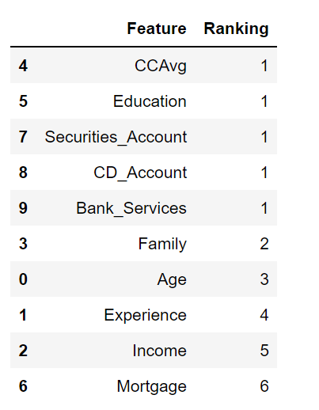
Data Pre-processing
Data Cleaning:
Duplicates entries where checked in data set and no duplicate rows were found which indicates Data is clean
Zip code was dropped as it doesn’t had any significant impact on target variable
ID also doesn’t had any significant impact on Personal loan, so it was used as Index for Data Frame
Removed outliers from Income,CCAvg, Mortgage and Age variables using IQR
Feature Engineering:
New Feature Bank_Services was used:
Variable Bank_Services was created combining Online and Credit card Variable & correlation with Personal loan was checked
New variable had better correlation with personal loan as compared to online and Credit card, so we dropped Online & CreditCard
Multicollinearity Check using VIF :(Variance –Inflation factor)
Experience and Age had very high VIF value as they were highly correlated
Experience was dropped as it had –ve enteries and also age was more
better at predicting the target variable
Feature Selection:
Selected features using RFE technique
RFE ranking showed CCAvg ,Education, Securities_Account,CD_Account and Bank_Services as the most important features.

Slide 13
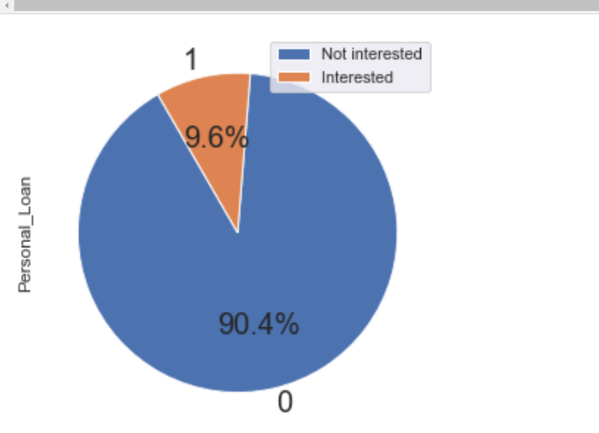
Modelling :
We would be analyzing the following models:
Logistic Regression
K-Nearest Neighbours
Decision Trees Classifier
Random Forest Classifier
Xgboost Classifier
Evaluation Metric :
Recall would be our evaluation metric as we would not like to miss customer who wanted to take personal loan but was identified as not interested customer by the model.
This would be a huge loss for the bank.
The whole purpose of the campaign was to target such customers.
Modelling Steps:
Identify the Dependent and Independent variables. Personal Loan will be dependent/target variable in our case
Split the Data into Train and test
Standardize the data using StandardScaler
Model Building
Evaluating model performance using different metrics
Target Visualization :
Target variable(Personal_Loan) has highly imbalanced class distribution.
Negative class (Personal_Loan=0) is much high than
positive class (Personal_Loan=1).
Imbalanced class distributions influence the performance of a machine
learning model negatively.
We used oversampling techniques to overcome this issue
like ROS,Smote,Smoteen.

Slide 14
Logistic Regression Overview :
Logistic regression is kind of like linear regression,but is used when the dependent variable is not a number but something else (e.g., a "yes/no" response).
It's called regression but performs classification based on the regression and it classifies the dependent variable into either of the classes.
Reasons for choosing :
Efficiency to train the model.
l1 and l2 regularization techniques, prevented the model from overfitting.
Operating and running the model was also a very simple, effective, and interpretable.
Random Over Sampling techniques used for handling class imbalance in the target variable.
Different variations :
LR_Model_1 (Without balancing the classes)
LR_Model_2 ( Hyperparameter Tuning and handling Class Imbalance )
LR_Model_3 (Using subset of features)
Observations on these models:
LR_Model_1:
Recall was low when classes were not balanced.
LR_Model_2:
Recall was good when the classes(0,1) in target variable(Personal_Loan) were balanced and hypertuning was applied. Also, False Negatives were quiet low.AUC score in this case was 0.96 which suggested model is good at predicting the two classes
LR_Model_3:
Recall was not good when used only some features.AUC score in this case was 0.87 which meant the model was not so good at predicting target class accurately.
Logistic Regression-Model Conclusion:
Model built after handling class imbalance and hyperparamete tuning was more reliable. Therefore, we would be considering this model for further analysis.

Slide 15
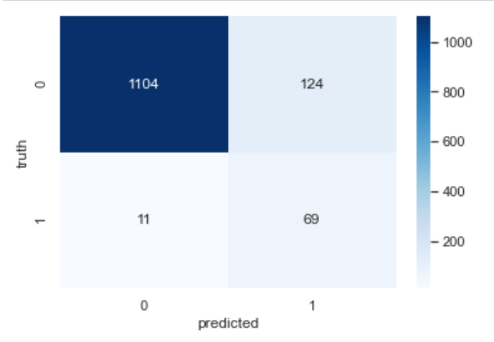
Logistic Regression Model- Confusion Matrix
Prediction on Train Data Set | Prediction on Test Data Set
Interpretation of confusion matrix:
Diagonal values represent accurate predictions, while non-diagonal predictions are not accurate. In the output, 1219 and 42 are actual predictions and 38 and 9 are innacurate predictions.
True Positive from our matrix :74
True Negative from our matrix :1094
False Positive from our matrix :9
False Negative from our matrix :6
Recall :
Train Data : 0.913
Test Data :0.887
We can see that Recall on both Train and test is same. Hence,model build is not overfittted.
Notes:
Prediction on Train Data Set
Prediction on Test Data Set

Slide 16
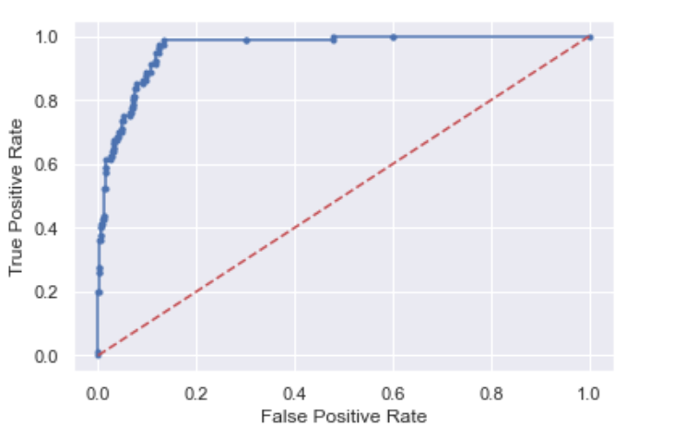
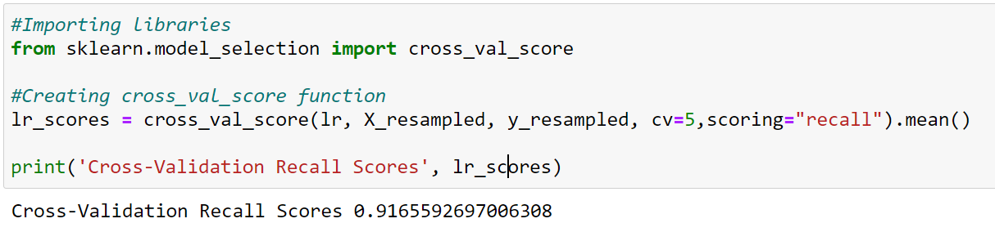
Logistic Regression Model- AUC ROC Curve and Cross Validation Score
From ROC curve we have value of 0.96, which means that our model is good
Cross Validation Recall score :0.916

Slide 17
KNN Overview :
K-NN algorithm assumes the similarity between the new case/data and available cases and put the new case into the category that is most similar to the available categories
K-NN algorithm can be used for Regression as well as for Classification problems
Reasons for choosing :
It’s easy to implement and tune
Only one hyper parameter to be set
Since it is doesn’t perform well on imbalanced data .Random Over Sampling techniques was used for handling class imbalance in the target variable.
Different variations :
KNN_Model_1 (Without balancing the classes)
KNN_Model_2 ( Hyperparameter Tuning and handling Class Imbalance )
KNN_Model_3 (Using subset of features)
Observations on these models:
KNN_Model_1 :
Recall was low when classes were not balanced.
KNN_Model_1 :
Recall was good when the classes(0,1) in target variable(Personal_Loan) were balanced and hypertuning was applied. Also, False Negatives were quiet low.AUC score in this case was 0.96 which suggested model is good at predicting the two classes
KNN_Model_1 :
Recall was not good when used only some features.AUC score in this case was 0.87 which meant the model was not so good at predicting target class accurately.
KNN Model - Conclusion:
Model built after handling class imbalance and hyperparameter tuning was more reliable. Therefore, we would be considering this model for further analysis.

Slide 19
Decision Tree Overview :
To be checked
Reasons for choosing :
It requires reduced effort for data preparation during pre-processing Only one hyper parameter to be set
Model does not require scaling of data, nor does it require normalization. However these stages have already been accounted for, for accuracy purposes.
These models are extremely fast and inexpensive to construct
Different variations :
DT_Model_1(Unoptimized + Class_weights)
DT_Model_2(Hyperparameter Tuning using GridSearchCV )
Observation on these models:
DT_Model_1(Unoptimized + Class_weights)
Recall Scores for train and test set were far apart
This suggests that the model is overfitting.
DT_Model_2(Hyperparameter Tuning using GridSearchCV )
Recall for test set has improved to 0.92 after hyperparameter tuning.
DT Model - Conclusion:
Model built after performing hyperparameter tuning was more reliable. Therefore, we would be considering this model for further analysis.

Slide 20
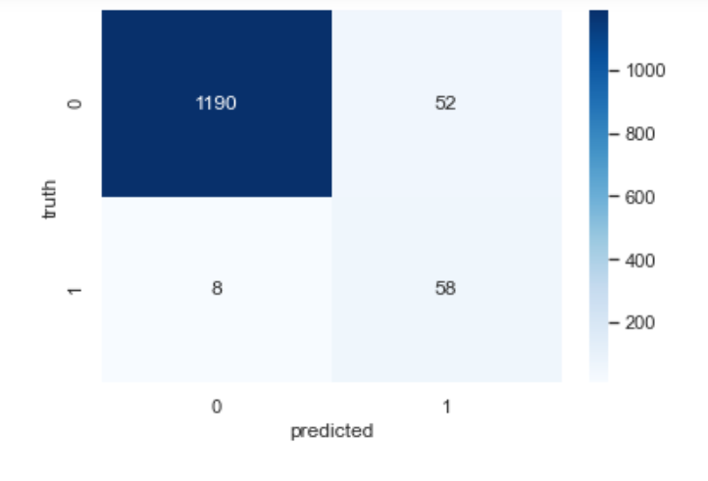
Prediction on Train Data Set | Prediction on Test Data Set
Interpretation of confusion matrix:
Diagonal values represent accurate predictions, while non-diagonal predictions are not accurate. In the output, 1219 and 42 are actual predictions and 38 and 9 are innacurate predictions.
True Positive from our matrix :74
True Negative from our matrix :1094
False Positive from our matrix :9
False Negative from our matrix :6
Recall :
Train Data : 0.895
Test Data :0.8787
Recall on both Train and test was almost same. Hence,model build was not overfittted.

Slide 22
Background
Thera Bank has a growing customer base.
Majority of these customers are depositors.
The bank is mostly interested in getting more borrowers in order to bring more loan business and ultimately earn through the interest on loans
In particular, the management wants to explore ways of converting its liability customers to personal loan customers (while retaining them as depositors).
Objective
To predict whether a liability customer will buy a personal loan or not.
Which variables are most significant.
Which segment of customers should be targeted more.

Slide 23
Method
Got dataset from Kaggle
Performed EDA on the dataset
Accessed using API key (Quandl)
Obtained records for 17 groups
Gender, Race/Ethnicity, Age, Highest Level of Education
Visualized with time series plots

